Slide 1
Systematic Testing of Distributed Systems
Burcu Kulahcioglu Ozkan
TU Kaiserslautern
Summer Term 2019

Slide 2
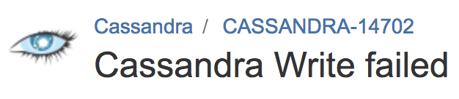


Distributed systems are prone to bugs!
Distribution
Asynchrony
Replication
…
They are difficult to test!
Many components, many sources of nondeterminism

Slide 3
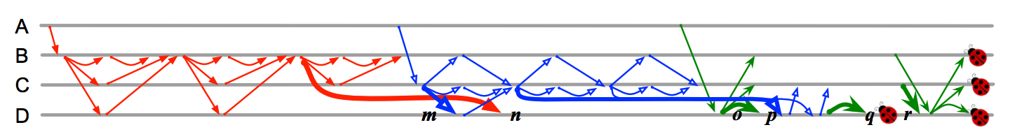
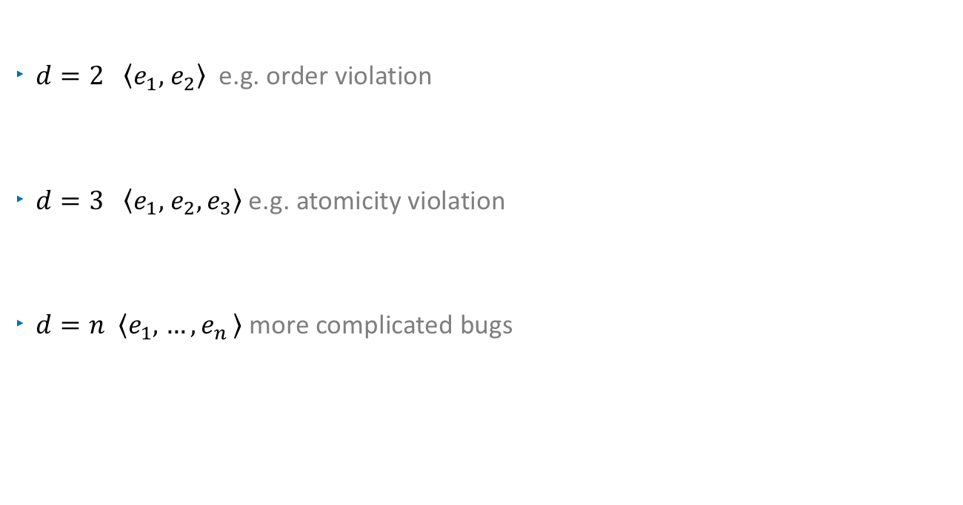
Distributed systems bugs are deep!
$d=2$ $\left\langle e_{1}, \right.\left.e_{2}\right\rangle$ e.g. order violation
$d=3$ $\left\langle e_{1}, \right.\left.e_{2}, e_{3}\right\rangle$e.g. atomicity violation
$d=n$ $\left\langle e_{1}, \right.\left.{…,e}_{n}\right\rangle$more complicated bugs
  Bug in Cassandra 2.0.0 (img. from Leesatapornwongsa et. al. ASPLOS’16)

Slide 4
How to detect bugs?
. . . . . . . . .
. . . . . . . .
. . . . . . . .
. . . . . . . . . . . . . . . . . . . . . . . . .
. . . . . . . .
. . . . . . . . . . .
. . . . . . . . . . .
Systematic testing - infeasible
Random testing (e.g. PCTCP, Jepsen)
Needs reduction techniques (e.g. SAMC, FlyMC)
. . . . . . . .
. . . . . . . . . . . . . . . . . . . . . . . . .
. . . . . . . .
. . . . . . . . . . .
Guided testing (e.g. Molly)

Slide 5
Combining Model Checking and Testing
state space exploration
Modeling languages
Model checking
abstraction
adaptation
Programming languages
state space exploration
Systematic testing
(applicable to real-word size software)

Slide 6
Systematic Testing of Distributed Systems
Explore the state space systematically
  Run time scheduler to exercise all possible sequences of events
  Ability to inject crash/reboot events
Infeasible to test all executions
  State space explosion problem
. . . . . . . . .
. . . . . . . .
. . . . . . . . . . .

Slide 7
A Simple Example
How many different executions does the system have?
E
F
A
B
C
D
G
H
Each node operates on its own local state
The messages to different nodes are commutative

Slide 8
Partial Order Reduction
Avoids redundantly exploring parts of the state space reachable by different executions
Exploits the commutativity of concurrent transitions
Based on the dependency relation between the transitions of a system
Dynamic Partial Order Reduction (DPOR) dynamically tracks interactions between transactions
t1
t2
s1
s2
t2
t1

Slide 9
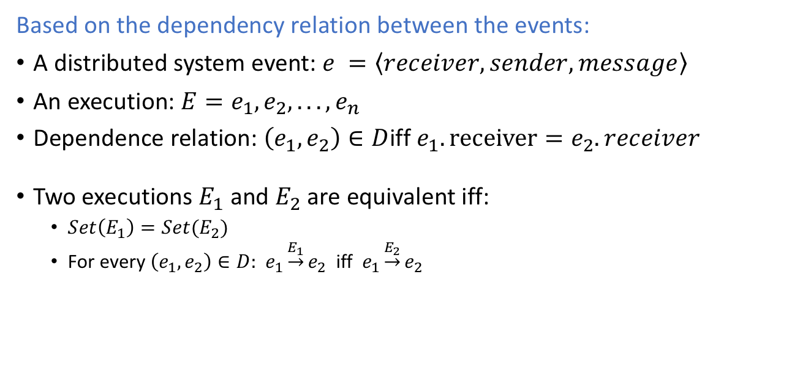
Partial Order Reduction for Distributed Systems
Based on the dependency relation between the events:
A distributed system event: $e =\left\langle receiver, sender, message\right\rangle$
An execution: $E=e_{1},e_{2}, . . . ,e_{n}$
Dependence relation: $\left(e_{1},e_{2}\right)∈D$iff $e_{1}.receiver=e_{2}.receiver$
Two executions $E_{1}$ and $E_{2}$ are equivalent iff:
  $Set\left(E_{1}\right)=Set(E_{2})$
  For every $\left(e_{1},e_{2}\right)∈D:$ $e_{1}\underset{→}{E_{1}}e_{2}$ iff $e_{1}\underset{→}{E_{2}}e_{2}$

Slide 10



Partial Order Reduction for Distributed Systems
E
F
A
B
C
D
G
H
  D partitions the state space
  into equivalence classes w.r.t $≡D$
A B C D E F G H $≡D$ A B C E F G H D
A B C D E F G H $≢D$ B A C D E F G H

Slide 11
A Complex Example
From “SAMC: Semantic-Aware Model Checking for Fast Discovery of Deep Bugs in Cloud Systems OSDI’14”

Slide 12
A Complex Example
Too many events,
multiple crashes and reboots!
From “SAMC: Semantic-Aware Model Checking for Fast Discovery of Deep Bugs in Cloud Systems OSDI’14”

Slide 13
SAMC-Semantic Aware Model Checking¹
Existing approaches for reduction is not sufficient
Classical DPOR
  Black box, exploits general properties of distributed systems
SAMC
  White-box, exploits system specific semantic information
Use system semantics for state space reduction
  Local Message Independence
  Crash Message Independence
  Crash Recovery Symmetry
  Reboot Synchronization Symmetry
¹ SAMC: semantic-aware model checking for fast discovery of deep bugs in cloud systems, OSDI’14

Slide 14
Local Message Independence
Some messages sent to a node are concurrent
A
B
C
D
A
B
C
D
Black box DPOR
ABCD
ABDC
ACBD
…
4! reorderings
White box DPOR
ABCD
ABDC
BACD
BADC
4 reorderings
(with message processing semantics)

Slide 15
Local Message Independence
Discard:
if(pd(m, ls))
noop;
Increment:
if(pi(m, ls))
ls ++;
Constant:
if(pc(m, ls))
ls = Const;
Modify:
if(pm(m, ls))
ls = modify(m, ls)
m1 is independent of m2 if pd is true for any of m1 and m2
m1 is independent of m2 if pi (or pc) is true on both m1 and m2
m1 and m2 are dependent if pm is true on m1 and pd is not true on m2
(they modify the state in unique ways)

Slide 16
Crash Message Independence
Some messages and node crashes are concurrent
E.g. Crash of a node N is concurrent with messages A, B, C, D
Global impact:
if(pg(X, ls))
modify(ls);
sendMsg();
Local impact:
if(pg(X, ls))
modify(ls);
Black box DPOR
ABCDX
ABCXD
ABXCD
AXBCD
XABCD
White box DPOR
ABCDX

Slide 17
Crash Recovery Symmetry
Guide the model checker with the crash decisions
Some crashes lead to symmetrical recovery behaviors
  In a 4-node system with FFFL, crashing the first and the second node may lead to the same behavior
  Two recovery actions are symmetrical if they produce the same message and update the local state in the same way
Needs to extract recovery logic

Slide 18
Reboot Synchronization Symmetry
Guide the model checker with the reboot decisions
A reboot will not lead to a new scenario if the current state of the system is similar to the state it crashed
Needs to extract reboot synchronization predicates and corresponding actions

Slide 19


Partial Order Reduction for Distributed Systems
Semantic information provides coarser equivalence of executions:
Semantic info
Equivalence w.r.t black box $D$
Equivalence w.r.t white box $D$
. . . . . . . . .
. . . . . . . .
. . . . . . . . . . .
Systematic testing with pruning

Slide 20
Summary
Systematic testing suffers from state space explosion problem
Partial order reduction techniques reduce the state space
  Generic notion of dependency – black box
  Semantic knowledge for fine grained dependency – white box
  Used for testing on Cassandra, Zookeeper, Hadoop
    Reduction ratio between 37x to 166x in model checking Zookeeper
Research Questions:
  What other semantic knowledge can scale MC distributed systems?
  How to extract the system specific white-box information?
  What other techniques can be used for an efficient systematic testing?

